Slide 1

[lte] long Term evolution
Mobile computing
Sahil jinadra – 37
Rohit joshi - 38

Slide 2
What is long term evolution ?
Long-Term Evolution (LTE) is a 3GPP project that provides extensions and modifications of the UMTS system allowing high data rate, low latency and packet optimised radio access networks. System Architecture Evolution (SAE) is an associated 3GPP project working on 3GPP core network evolution. The new air interface and network architecture aim at providing decreased cost per transmitted bit, achieved by:
Advanced modulation techniques that allow optimised use of radio frequency.
Flat architecture that minimises the number of network elements and optimises the usage of the transmission network.
Capability to serve high quality, low latency real-time traffic, allowing both voice and data services to be provided over a single all-IP network.

Slide 3
Key features of lte
High Data Rates: LTE offers high data rates, with theoretical peak download speeds of up to 300 Mbps and upload speeds of up to 75 Mbps.
Low Latency: LTE networks have low latency, which means faster response times for interactive applications like online gaming and video calling.
Efficient Spectrum Use: LTE uses spectrum more efficiently than previous technologies, allowing for more users and higher data rates in the same amount of spectrum.
Backward Compatibility: LTE networks are backward compatible with 2G and 3G networks, ensuring that users can still connect to older networks when LTE is not available.
Quality of Service (QoS) : LTE supports different levels of QoS, allowing operators to prioritize traffic based on application requirements.
IP-Based Network: LTE is based on an all-IP network architecture, which simplifies the network and enables seamless integration with other IP-based services.
VoLTE (Voice over LTE): LTE supports voice calls over the data network, providing higher quality voice calls compared to traditional circuit-switched voice calls.

Slide 4
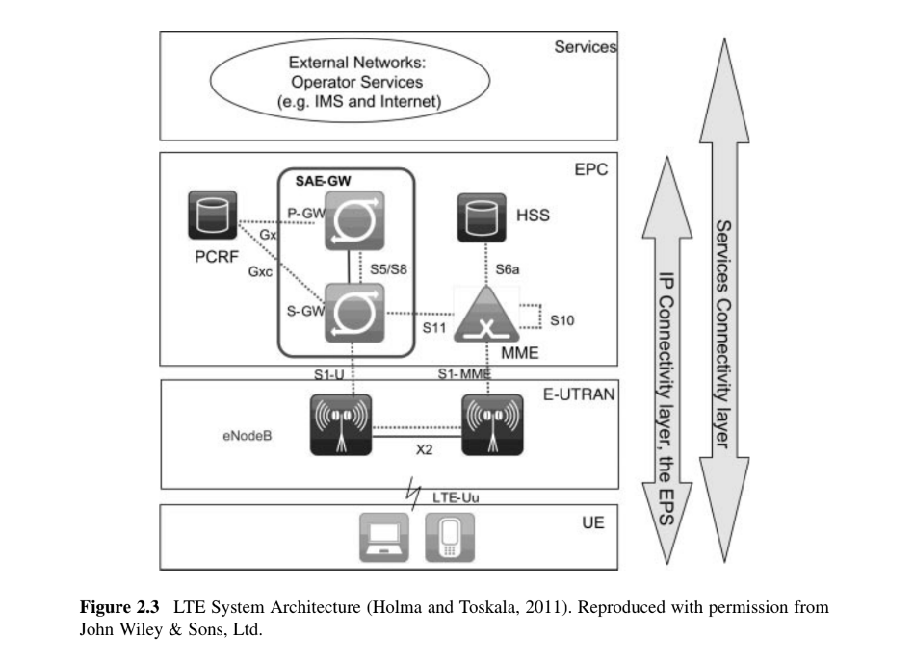
Architecture of LTE
UE – User Entity
eNodeB – evolved NodeB (BS)
S-GW – serving gateway
P-GW - PDN gateway
MME – mobility management entity
PCRF – policy rules and charging control functions
HSS - home subscriber server
IMS – IP multimedia subsystem

Slide 5
Network element used in lte
Evolved Packet Core (EPC): The EPC is the core network of LTE, consisting of several elements:
Mobility Management Entity (MME): The MME is the central element in the EPC and it provides a logically direct Control plane connection with the UE. The MME manages and stores UE context, generates temporary identities and allocates them for UEs, authenticates the user, manages mobility and bearers, and is the termination point for NAS signalling.
Home Subscriber Server (HSS): The HSS is the subscriber database that stores user-related information, including authentication and subscription profiles.
Serving Gateway (SG-W): The SGW is responsible for routing user data packets within the LTE network, as well as mobility anchoring during inter-eNodeB handovers. The SGW forwards user data packets between the UE and the PGW. It optimizes the routing of data packets to minimize latency and ensure efficient use of network resources.

Slide 6
Packet Data Network Gateway (P-GW): The PGW is the gateway between the LTE network and external packet data networks, such as the internet or corporate networks. It is responsible for IP address allocation and QoS enforcement. The PGW allocates IP addresses to user equipment (UE) when they connect to the LTE network. It manages the assignment and release of IP addresses to ensure efficient use of IP resources.
Policy and Charging Rules Function (PCRF): The PCRF is responsible for policy control and flow-based charging in the LTE network. It determines the policies for QoS, charging, and access control based on subscriber and network conditions. The PCRF defines and enforces policies related to Quality of Service (QoS), such as data rate limits, priority levels, and traffic handling rules.

Slide 7
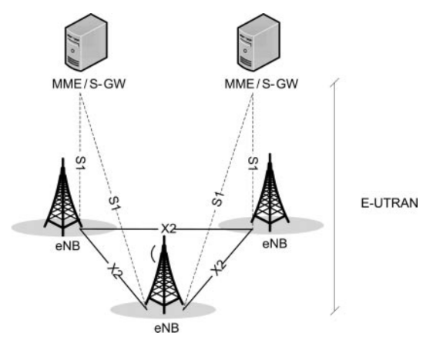
eNodeB (BS): The eNodeB is the LTE base station that communicates directly with user devices (UEs). It is responsible for radio resource management, including radio bearers' setup and release, handovers, and scheduling.
IMS Core: The IMS (IP Multimedia Subsystem) Core provides multimedia services, such as voice over LTE (VoLTE) and video calling, over an IP network. It includes elements like the Call Session Control Function (CSCF) and the Home Subscriber Server (HSS).
UE: (UE) is the user entity. It refers to the mobile device or terminal used by an individual to access LTE services. The UE communicates with the LTE network through the eNodeB (base station) and is responsible for initiating connections, transmitting and receiving data, and performing mobility-related functions such as handovers between cells.

Slide 8
Technologies used in lte
OFDMA (Orthogonal Frequency Division Multiple Access): OFDMA is the multiple access scheme used in the downlink (from the base station to the user device) in LTE.
SC-FDMA (Single Carrier Frequency Division Multiple Access): SC-FDMA is used in the uplink (from the user device to the base station) in LTE. It is chosen for its lower peak-to-average power ratio compared to OFDMA, which helps in improving power efficiency for mobile devices.
MIMO (Multiple Input Multiple Output): LTE utilizes MIMO technology to improve spectral efficiency and link reliability. It involves the use of multiple antennas at both the transmitter and receiver to transmit multiple data streams simultaneously, thereby increasing data rates and improving coverage.
LTE Advanced: LTE Advanced is an enhanced version of LTE that introduces additional features to further improve performance. It includes technologies such as carrier aggregation, which allows for the combination of multiple LTE carriers to increase bandwidth and data rates.
VoLTE (Voice over LTE): VoLTE enables voice calls to be made over LTE networks using IP-based protocols. It provides better voice quality and faster call setup times compared to traditional circuit-switched voice calls.

